Slide 1
Explainable Longitudinal Digital Twin for Glioma Progression
Shahla Newas
Maiesa Siddika
0182320012101393
0182320012101319
Fahmida Iqbal Yesha
Tuli Rani Das
0182320012101329
0182320012101337
Rahma Ferdous Lima
Samiya Akhter Anika
0182320012101341
0182320012101355
01

Slide 2

Dataset Verification & Geometry Checks
Dataset at a Glance
Preprocessing
298
1
Normalize
Patients
2
Crop & Pad
Longitudinal cohort
3
Resize to 224 × 224
1,788
MRI Files
Multi-modal scans
0
Missing Files
Verified complete
02

Slide 3

Input Structure & Data Partition
Tensor & Features
Dataset Split
MRI Input
Train
Validation
48 slices, 2 channels (FLAIR + T1CE)
208 patients
45 patients
Clinical Features
Test
Age, Sex, Diagnosis
45 patients
Temporal Pairing
Time1 / Time2 matched pairs
03

Slide 4

Baseline Models & Results
Validation set.
Clinical-Only
Time1 CNN
Time2 CNN
44.44% Accuracy
F1: 0.4009
53.33% Accuracy
F1: 0.2676
53.33% Accuracy
F1: 0.3251
Takeaway
Accuracy is similar; F1 separates the models.
Single-timepoint models are not reliable enough.
04

Slide 5
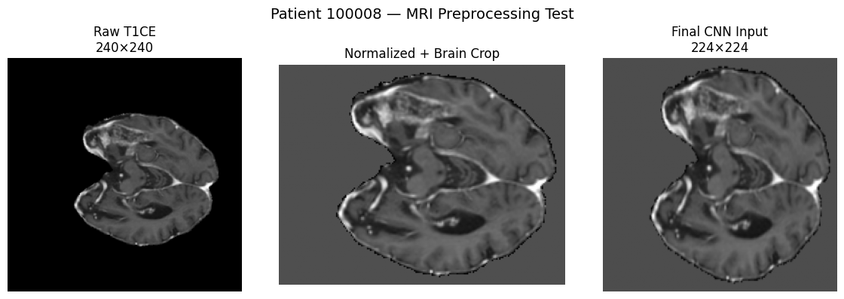
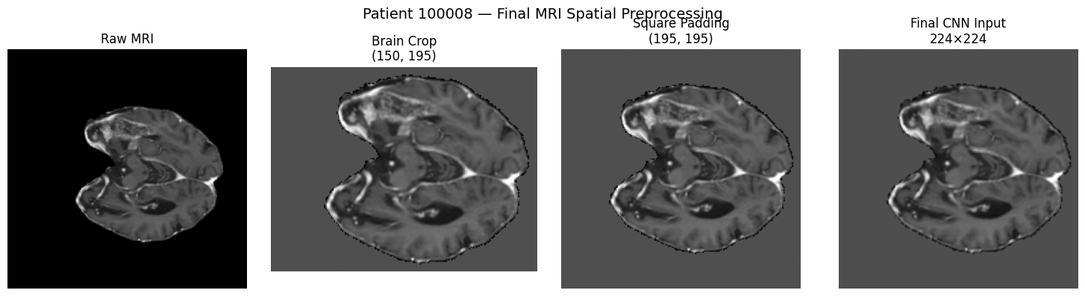
05

Slide 6
Shared-Weight Siamese CNN
Architecture
Validation
01
MRI-Only Siamese
Siamese + Clinical
Shared Encoders
44.44% accuracy
42.22% accuracy
Time1 and Time2 MRI volumes pass through identical CNN branches with shared weights.
ΔF alone is not sufficiently discriminative.
02
Temporal Delta
Features are differenced to form ΔF = F₂ − F₁.
03
Clinical Fusion
ΔF is combined with Age, Sex, and Diagnosis for classification.
06

Slide 7



Attention Slice Pooling Breakthrough
60.00%
Attention-Based Slice Pooling
The model learns slice weights, giving more importance to diagnostically relevant slices.
Validation Accuracy
F1 Score: 0.4006
Salience
Relevant slices get higher weight.
Best MRI model in the study.
+6.67 pts over single-timepoint CNN baselines.
Gain
Largest accuracy jump in the pipeline.
Noise Reduction
Uninformative slices are down-weighted.
07

Slide 8
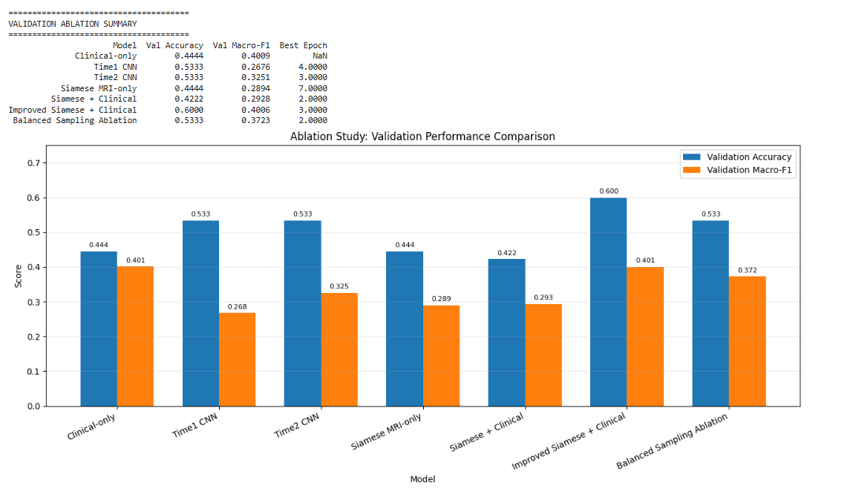
6B
Ablation Study Comparison
Validation performance across model configurations
08
Validation Accuracy and Macro-F1 across the ablation settings.
Ablation Study

Slide 9
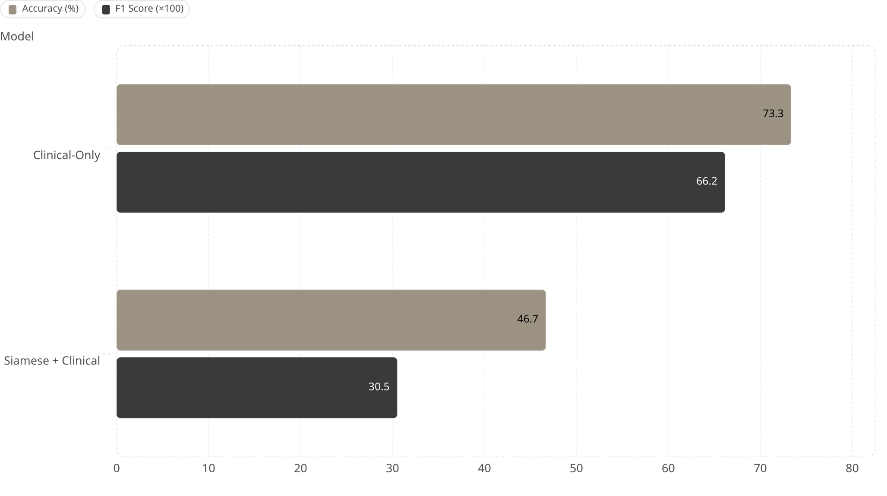
Test Set Benchmark — N = 45
Held-out test set. Clinical-Only outperformed Siamese+Clinical.
09

Slide 10
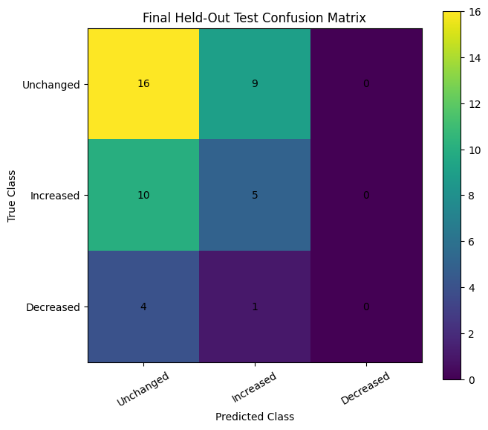
10

Slide 11
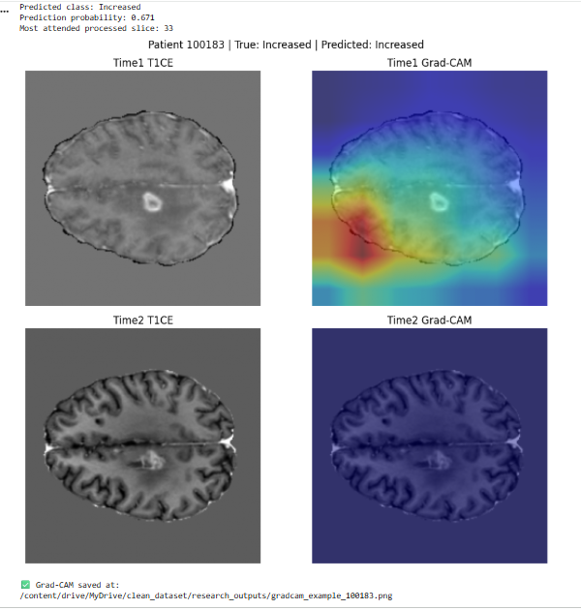
Patient 100183 Attention Visualization
MRI inputs and Grad-CAM explanations at Time 1 and Time 2
11
True: Increased • Predicted: Increased • Probability: 0.671
Patient-level temporal attention

Slide 12


Explainability: Signed Grad-CAM
Ground Truth Overlap
Zero-Map Collapse
Naïve Grad-CAM on ΔF = F₂ − F₁ can cancel positive and negative gradients, producing near-zero saliency maps.
1.10%
Signed Grad-CAM
Dice — T1
Preserves gradient sign through the subtraction layer, yielding meaningful progression vs. stability saliency.
1.19%
Dice — T2
Low overlap suggests weak spatial alignment with the tumor mask.
12

Slide 13
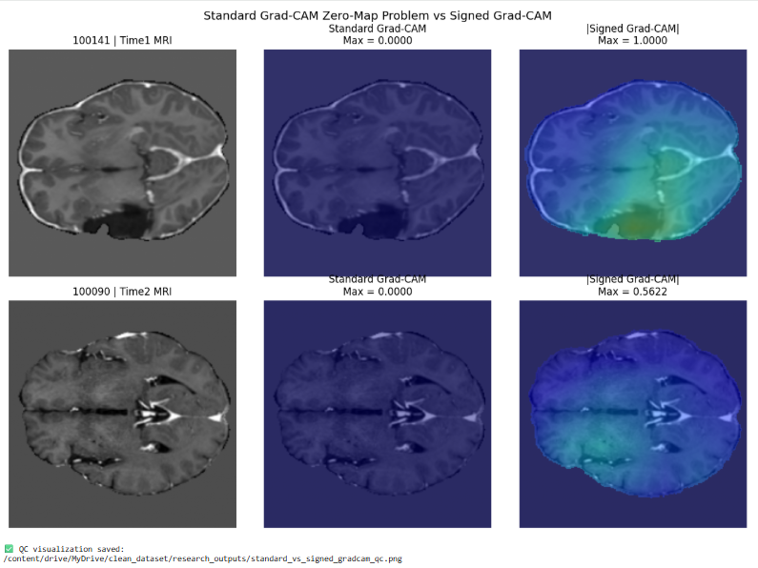
Signed Grad-CAM QC Comparison
Standard Grad-CAM zero maps versus informative signed attributions
13
Signed Grad-CAM preserves informative attribution where standard Grad-CAM can collapse to zero.

Slide 14

Temporal Attention Validation
Central Question
Statistical Finding
Does attention track tumor change over time?
Not Supported
Alignment Scores
p > 0.05
Single-Label
Multi-Label
Takeaway
0.0039
−0.0012
Attention helps classification, not temporal interpretability.
Next Step
Supervise attention with segmentation masks.
Null results clarify the limits of unsupervised attention in longitudinal MRI.
14

Slide 15
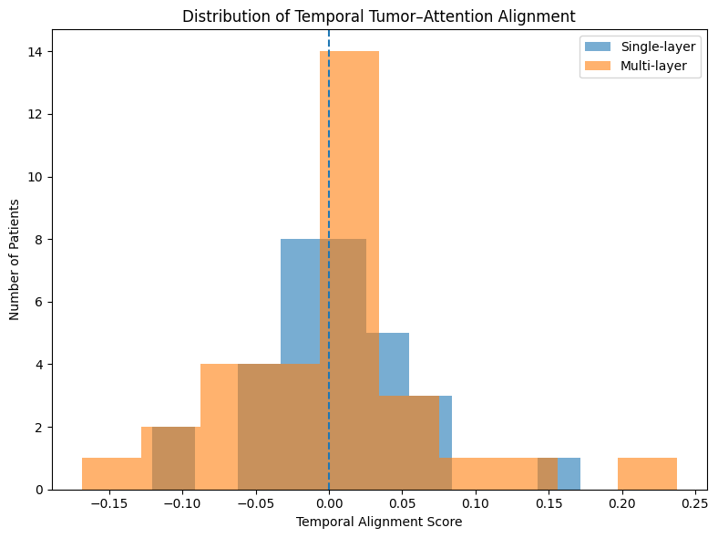
15

Slide 16

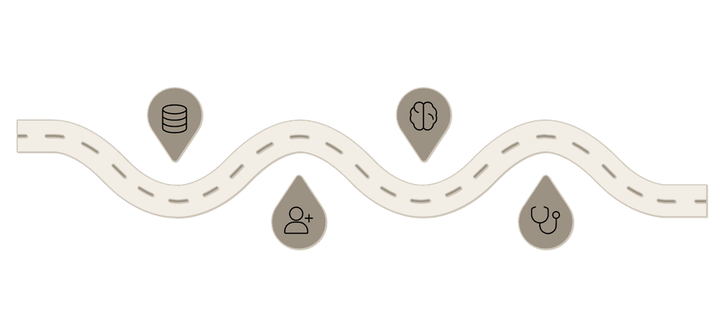


Digital Twin Prototype & Future Vision
Latent Space Architecture
Roadmap to Clinical Integration
Latent Validation
XAI Alignment
128-D Embedding
Verify 128-D embedding
Improve interpretability
Compressed patient-level state for similarity search and trajectory modeling.
Multi-Modal Fusion
Cohort Expansion
Clinical Pilot
MRI, clinical covariates, and temporal delta ΔF.
Broaden similarity sets
Deploy in trials
Attention Slice Pooling — 60% validation accuracy, +6.67pp vs. baselines
Personalized Twin
Signed Grad-CAM — first longitudinal glioma MRI application
Supports progression simulation and treatment response estimation.
Digital Twin Embedding — 128-D personalized representation
16

Slide 17
Thank You
Thank you for your time and attention.
17

